Slide 1
View Controllers
iOS

Slide 2
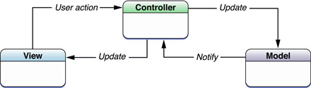
Model-View-Controller (MVC) paradigm
Many Cocoa technologies and architectures are based on MVC and require that the application custom objects play one of the MVC roles.

Slide 3
View Controllers
A type of controller object to present and manage a set of views.
The main job of a view controller is to load and unload its view as needed.
View controller objects are descendants of the UIViewController class, which is defined in the UIKit framework.
3 types of view controllers:
Custom view controller (Content view controller) : responsible for managing all of the views in a single view hierarchy
Container view controller: controller of controllers
Modal view controller

Slide 4
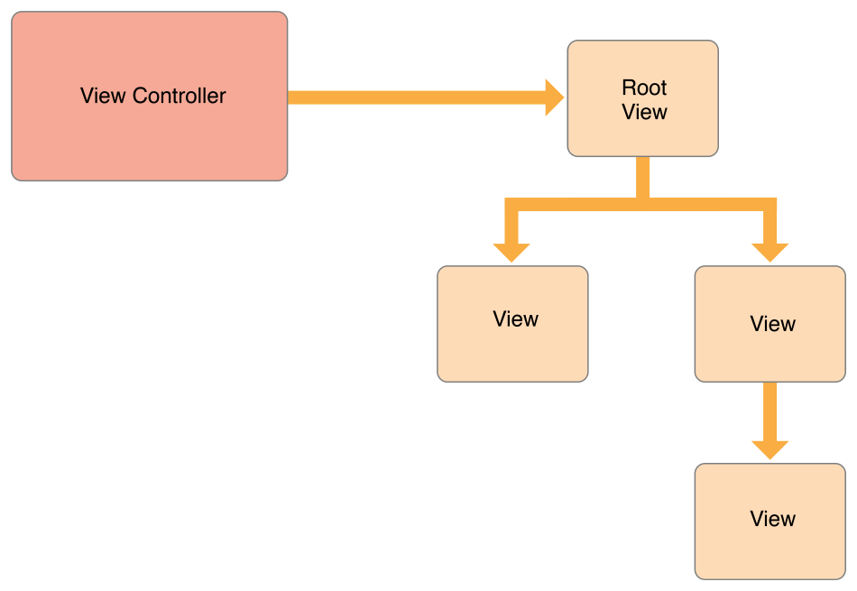
(View Management)

Slide 5
View Controllers
The job of each view controller object is two-fold:
responsible for coordinating interactions between the application’s visual presentation (the custom views) and the application’s data model (the custom objects).
responsible for handling changes to the views that comprise its view layer.
When the user rotates a device from a portrait to a landscape orientation, the view controller is responsible for reorienting the views accordingly.
A view controller is the sole owner of its view and any associated subviews.
It is responsible for creating those views and for releasing them at the appropriate times, including during low-memory conditions and when the view controller itself is released.
View controllers are responsible for the presentation of their views and for adapting that presentation to match the underlying environment.

Slide 6
View Controllers
instances of the UIViewController class
Manage the structure of the user interface and the presentation of views within that interface.
Applications have a limited amount of space in which to display content. Rather than display new windows, an application uses view controllers to swap out the views in the current window.
The type of the view controller and the way that view controller is presented determine the type of animation that is used to display the new views.
Each view controller object can be thought of as a self-contained unit.
handles the creation and destruction of its own views,
resizes and lays out its views
handles their presentation on the screen, adjusts the contents
coordinates interactions between the views and other objects in your application.
The view controller may manage all of the views on its own or use helper objects to manage subsets of views.
The view controller is always in charge of presenting the overall view hierarchy and is ultimately responsible for the views.

Slide 7
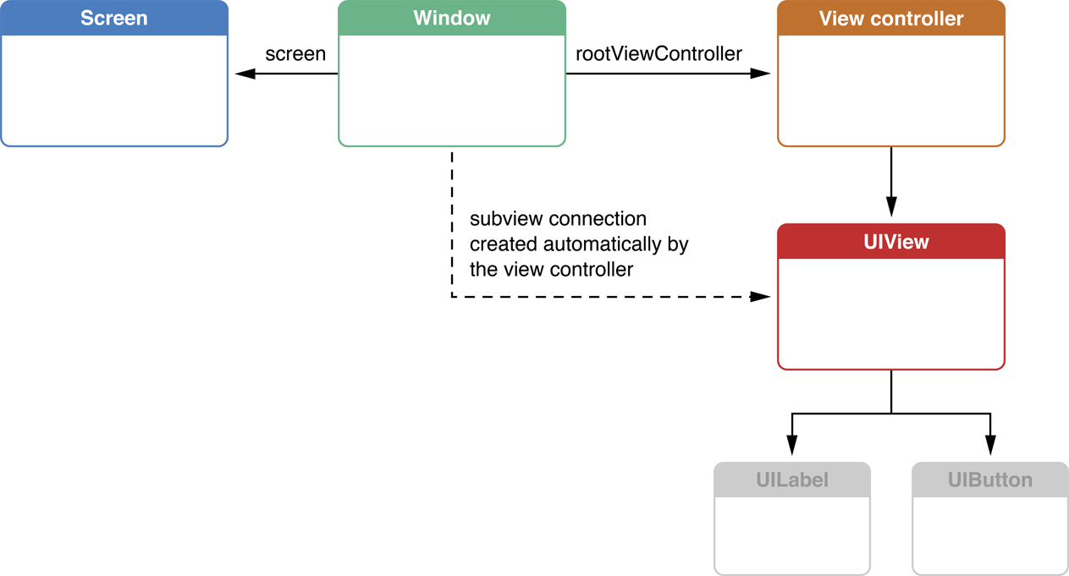
A view controller attached to a window automatically adds its view as a subview of the window

Slide 8
User Interactions
View controllers are descendants of the UIResponder class and are inserted into the responder chain between the managed root view and its superview, which typically belongs to a different view controller.
If the view controller’s view does not handle an event, the view controller has the option of handling the event or it can pass the event to the superview.

Slide 9
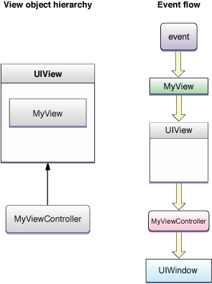
Handling Events
If the view does not handle an event, it is passed along to the parent view. Because the generic view does not handle events, it passes those events along to its view controller first.

Slide 10
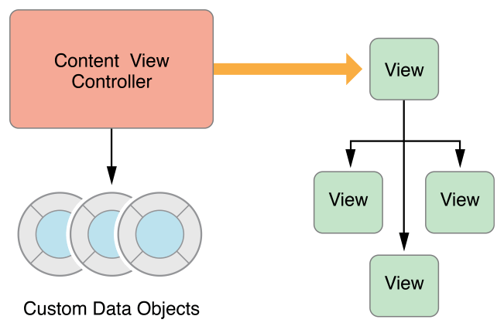
(Data Marshaling)
A view controller mediates between data objects and views

Slide 11
var view: UIView! { get set }
represents the root view for the view controller’s view hierarchy. The default is nil.
init(nibName nibNameOrNil: String?, bundle nibBundleOrNil: Bundle?)
nibNameOrNil: name of the nib file without the extension. If nil, the nibName property is set to nil.
nibBundleOrNil: The bundle in which to search for the nib file.
If no .xib is found, UIViewController will call - (void)loadView on itself.
loadView’s implementation MUST set the view property in the UIViewController.
viewDidLoad is called when UIViewController is initialized. ( but bounds is not set yet)

Slide 12
func viewWillAppear(_ animated: Bool)
Just before the view appears on screen
When this is called, the bounds has been set.
A view is usually loaded once, but it might appear and disappear many times.
func viewWillDisappear(_ animated: Bool)
When the view disappears from the screen
Also:
func viewDidAppear(_ animated: Bool)
func viewDidDisappear(_ animated: Bool)
func viewDidLoad()
Called after the controller’s view is loaded into memory.
Also:
var isViewLoaded: Bool
var viewIfLoaded: UIView? { get }

Slide 13
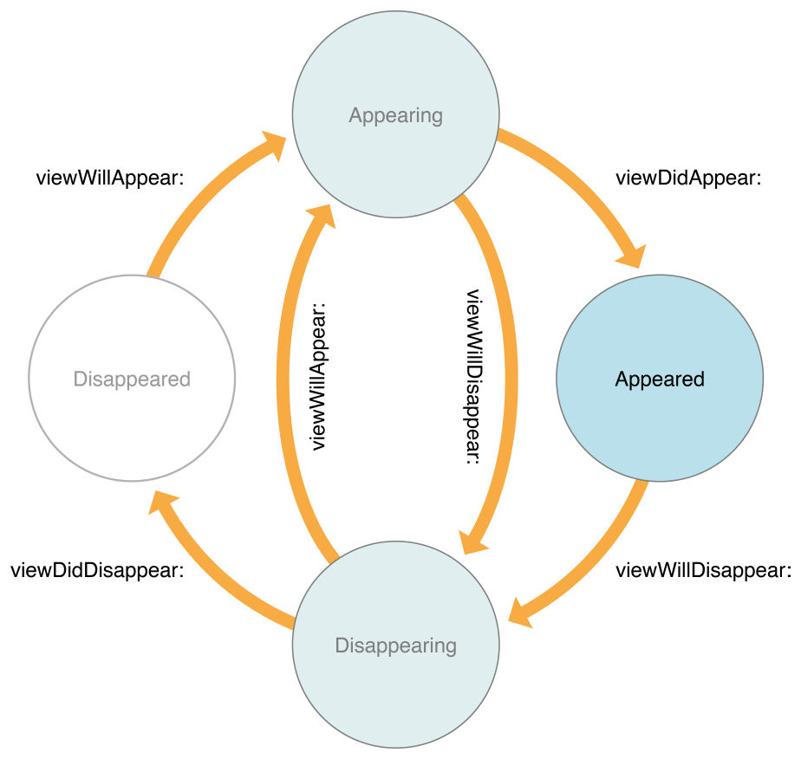
The View Controller Lifecycle

Slide 14
Assign a view
Manually
implement the loadView method and use it to assign a root view object to the view property.
Using a nib file
Initialize the view controller object using the init(nibName:bundle:) method.
Using storyboard
func instantiateViewController(withIdentifier identifier: String) -> UIViewController
on a UIStoryboardobject

Slide 15
Reacting to device rotation
As of iOS 8, all rotation-related methods are deprecated.
viewWillTransition(to:with:)
Notifies the container that the size of its view is about to change.
When the interface orientation changes, UIKit calls this method on the window’s root view controller.
Rotation notifications: (called when there is a rotation)
willRotate(to:duration:),
willAnimateRotation(to:duration:), and
didRotate(from:)
override the preferredInterfaceOrientationForPresentation
The viewWillLayoutSubviews method is also called after the view is resized and positioned by its parent.
When a view controller is displayed on screen, its root view is typically resized to fit the available space.
configure the autoresizing properties using the autoresizesSubviews and autoresizingMask properties of each view.

Slide 16
In iOS6+
shouldAutorotateToInterfaceOrientation: deprecated.
By default, an app and a view controller’s supported interface orientations are set to:
iPad : UIInterfaceOrientationMask.all
iPhone:UIInterfaceOrientationMaskAllButUpsideDown
- (BOOL)shouldAutorotate;
var supportedInterfaceOrientations: UIInterfaceOrientationMask
A bit mask specifying which orientations are supported.
See “UIInterfaceOrientationMask” for valid bit-mask values.
The value returned by this method must not be 0.
var preferredInterfaceOrientationForPresentation: UIInterfaceOrientation;
Returns the interface orientation to use when presenting the view controller.

Slide 17
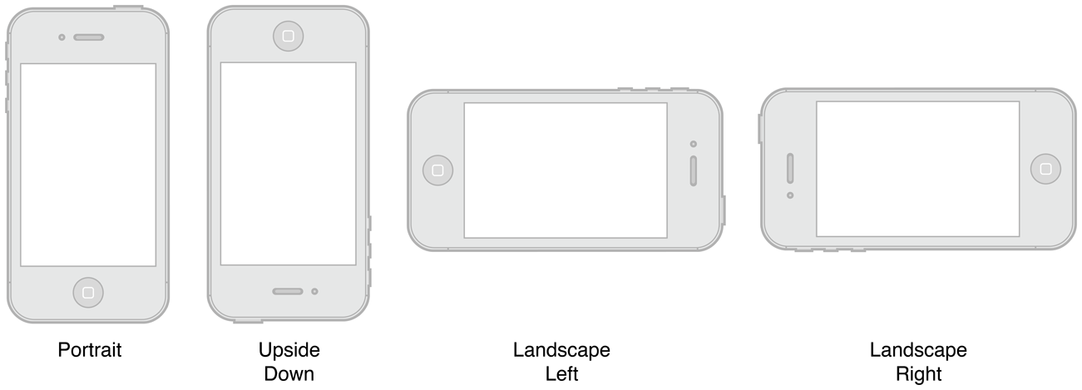
You should always choose the orientations your view supports at design time
However you can always override the supportedInterfaceOrientations method:
(NSUInteger) supportedInterfaceOrientations {
return UIInterfaceOrientationMaskPortrait | IInterfaceOrientationMaskLandscapeLeft;
}
Or temporarily disable automatic rotation, by overriding the shouldAutorotate method on the topmost view controller.
If the layout code needs to know the current orientation of the device, it can read the app object’s statusBarOrientation property to determine the current orientation or register for the rotation events on the UIDevice class.

Slide 18
As of iOS 8, all rotation-related methods are deprecated. Instead, rotations are treated as a change in the size of the view controller’s view and are therefore reported using the:
viewWillTransitionToSize:withTransitionCoordinator: method.
You can override the preferredInterfaceOrientationForPresentation for a view controller that is intended to be presented full screen in a specific orientation.
When a rotation occurs for a visible view controller, the
willRotateToInterfaceOrientation:duration:, willAnimateRotationToInterfaceOrientation:duration:, and didRotateFromInterfaceOrientation: methods
are called during the rotation. The viewWillLayoutSubviews method is also called after the view is resized and positioned by its parent.

Slide 19
For Container View Controllers
Here are the essential methods you might need to call:
addChildViewController:
- removeFromParentViewController
- willMoveToParentViewController:
didMoveToParentViewController:
var childViewControllers: [UIViewController]
An array of view controllers that are children of the current view controller
These methods are not intended to be called by clients of the container class.

Slide 20
Configuring the Initial View Controller at Launch
When using main nib window or storyboard, iOS automatically does a lot of work
to set up the app. When the app calls the UIApplicationMain function,
iOS performs the following actions:
It instantiates the app delegate based on the class name you passed into the
UIApplicationMain function.
It creates a new window attached to the main screen.
If the app delegate implements a window property, iOS sets this property to the new window.
It loads the main storyboard referenced in the app’s information property list file.
It instantiates the main storyboard’s initial view controller.
It sets the window’s rootViewController property to the new view controller
It calls the app delegate’s application:didFinishLaunchingWithOptions: method.
Your app delegate is expected to configure the initial view controller
(and its children, if it is a container view controller).
It calls the window’s makeKeyAndVisible method to display the window.

Slide 21
Edit Mode in a View Controller
The same view controller can be used both to display and to edit content.
When the editing mode is toggled, the custom view controller performs the necessary work to transition its view from a display mode to an editing mode (or vice versa).
Need to override the setEditing:animated: method, for custom view controllers
The point of using the setEditing:animated: method is so that you can make small changes to existing views not to swap the entire view
To toggle between modes modify the value of the view controller’s editing property
Or by adding editButtonItem to the navigation bar ( in a navigation model)

Slide 22
Memory Management (Resource Management)
The UIViewController class provides some automatic handling of low-memory conditions through its didReceiveMemoryWarning method, which releases unneeded memory.
Prior to iOS 6, when a low-memory warning occurred, the UIViewController class purged its views if it knew it could reload or recreate them again later.
If this happens, it also calls the viewWillUnload and viewDidUnload methods to give the code a chance to clean up ( relinquish ownership of any objects that are associated with the view hierarchy, including objects loaded from the nib file, objects created in the viewDidLoad method, and objects created lazily at runtime and added to the view hierarchy.
On iOS 6+, views are never purged and these methods are never called. If the view controller needs to perform specific tasks when memory is low, it should override the didReceiveMemoryWarning method.

Slide 23
Presenting a View Controller’s View
There are several options for displaying the view associated with a view controller:
Display the view directly by adding it to a window using the addSubview: method.
Display the view indirectly using one of the following techniques:
Present the owning view controller modally using the present(_:animated:completion: ) method.
Push the owning view controller onto the navigation stack of a navigation controller object.
pushViewController(_:animated:)
Make the owning view controller the root view controller of a tab in a tab bar interface.
Present the view controller using a popover. ( used to be in iPad only. Now available for both)

Slide 24
rootViewController property of UIWindow
The root view controller for the window.
var rootViewController: UIViewController? { get set }
Provides the content view of the window.
Assigning a view controller to this property (either programmatically or using Interface Builder) installs the view controller’s view as the content view of the window.
If the window has an existing view hierarchy, the old views are removed before the new ones are installed.
The default value of this property is nil.

Slide 25
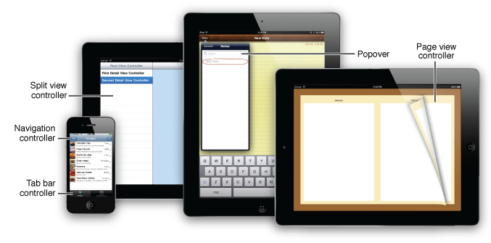

Slide 26
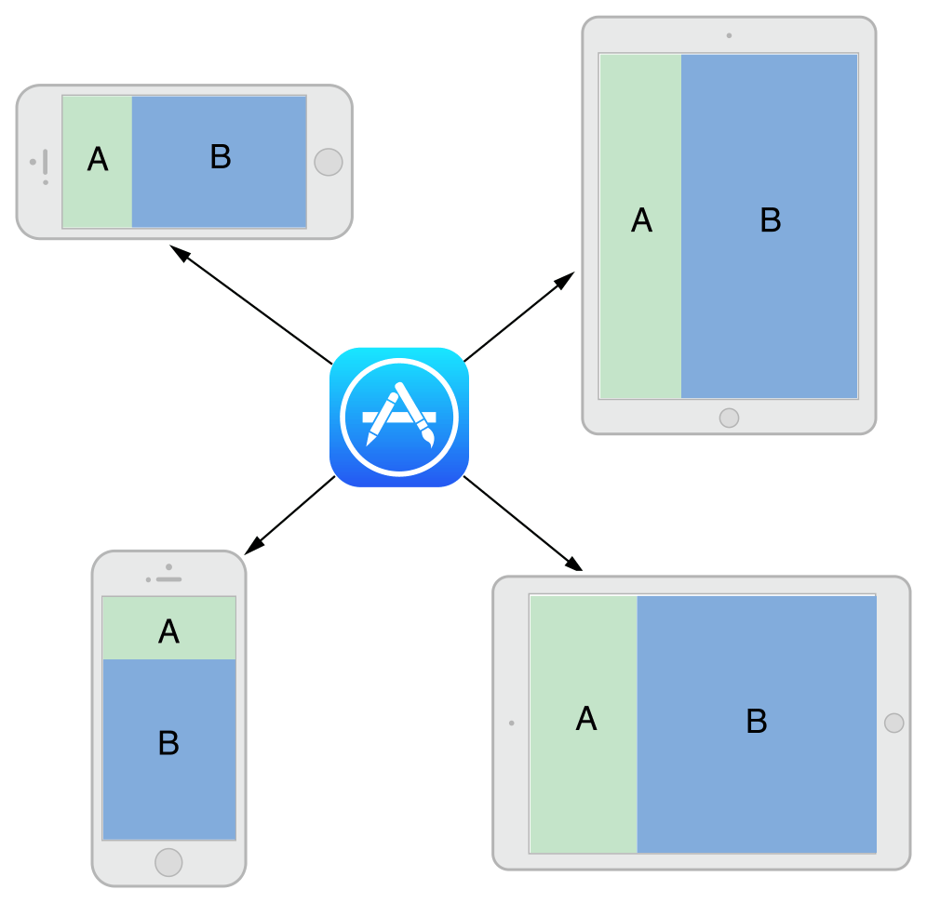
An adaptive interface is one that makes the best use of the available space.
Being adaptive means being able to adjust your content so that it fits well on any iOS device.
Auto Layout: define rules (known as constraints) that govern the layout of the view controller’s views.
Traits describe the environment in which the view controllers and views must operate. Traits make high-level decisions about the interface.
The Adaptive Model
(Adaptivity)

Slide 27
Content View Controller
Presents content on the screen using a view or a group of views organized into a view hierarchy.
A content view controller usually knows about the subset of the app’s data that is relevant to the role the controller plays in the app.
Here are common examples where to use content view controllers:
To show data to the user
To collect data from the user
To perform a specific task
To navigate between a set of available commands or options, such as on the launch screen for a game
Content view controllers are the primary coordinating objects for your app because they know the specific details of the data and tasks your app offers the user.
Each content view controller object created is responsible for managing all the views in a single view hierarchy.
The one-to-one correspondence between a view controller and the views in its view hierarchy is the key design consideration.
You should not use multiple content view controllers to manage the same view hierarchy.
Also, you should not use a single content view controller object to manage multiple screens’ worth of content.

Slide 28
Modal View Controllers
Any view controller can be presented modally by an application
To present a view controller modally, do the following:
Create the view controller to present.
Set var modalPresentationStyle: UIModalPresentationStyle property of the view controller to the desired value.
.fullscreen , .PageSheet, .formSheet, .currentContext, .custom, .overFullScreen, .blurOverFullScreen
Set the modalTransitionStyle property of the view controller to the desired value.
UIModalTransitionStyle.coverVertical , .flipHorizontal, .crossDissolve, .partialCurl
Assign a delegate object where appropriate. (The delegate is used primarily by system view controllers to notify the code when the view controller is ready to be dismissed. )
Call the present(_:animated:completion: ) method of the current view controller, passing in the view controller to present modally.
Call dismiss(animated:completion:) Dismisses the modal view controller that was presented by the receiver.

Slide 29
In iOS 5.x,modal presentations can use four transition styles:
Slide—This transition style slides a new view over the old.
Fade—This transition style dissolves the new view into visibility.
Flip—This transition style turns a view over to the “back” of the presentation.
Curl—This transition style makes the primary view curl up out of the way to reveal the new view beneath it.
iPad offers three more presentation styles:
Full Screen—A full-screen presentation is the default on the iPhone, where the new modal view completely covers both the screen and any existing content. This is the only presentation style that is legal for curls—any other presentation style raises a runtime exception, crashing the application.
Page Sheet—In the page sheet, coverage defaults to a portrait aspect ratio, so the modal view controller completely covers the screen in portrait mode and partially covers the screen in landscape mode, as if a portrait-aligned piece of paper were added to the display.
Form Sheet—The form sheet display covers a small center portion of the screen, allowing you to shift focus to the modal element while retaining the maximum visibility of the primary application view.

Slide 30
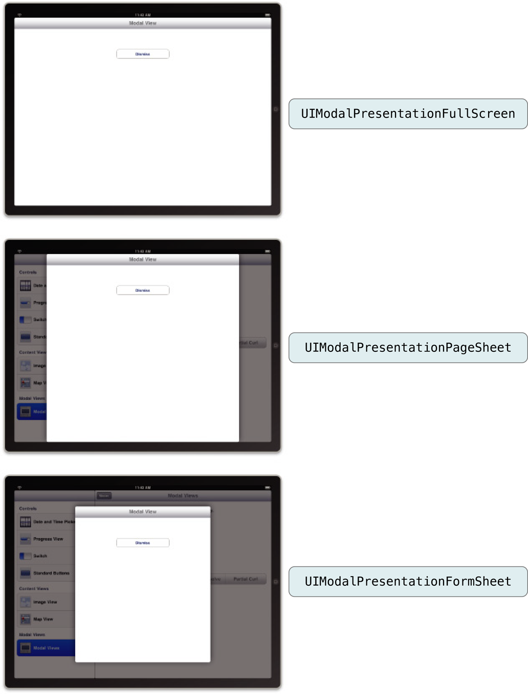

Slide 31
case fullScreen
A presentation style in which the presented view covers the screen.
case pageSheet
A presentation style that partially covers the underlying content.
case formSheet
A presentation style that displays the content centered in the screen.
case currentContext
A presentation style where the content is displayed over another view controller’s content.
case custom
A custom view presentation style that is managed by a custom presentation controller and one or more custom animator objects.
case overFullScreen
A view presentation style in which the presented view covers the screen.
case overCurrentContext
A presentation style where the content is displayed over another view controller’s content.
case blurOverFullScreen
A presentation style that blurs the underlying content before displaying new content in a full-screen presentation.
case popover
A presentation style where the content is displayed in a popover view.
case none
A presentation style that indicates no adaptations should be made.

Slide 32
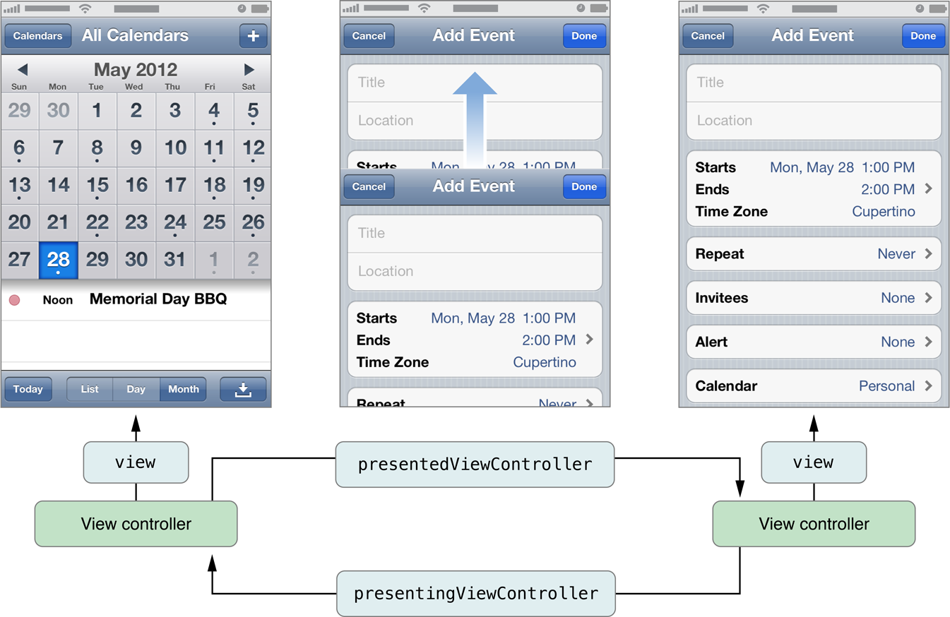
How View Controllers Present Other View Controllers (iOS 5.0 and later)

Slide 33
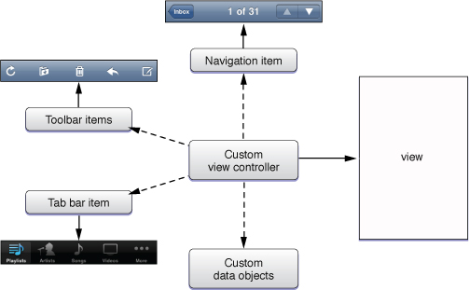
Anatomy of a View Controller

Slide 34
The Load Cycle
When the view is referenced for the first time in the controller’s view property.
If the view is not currently in memory, the view controller calls its loadView method.
The loadView method does one of the following:
If you override this method, your implementation is responsible for creating all necessary views and assigning a non-nil value to the view property.
If you do not override this method, the default implementation uses the nibName and nibBundle properties of the view controller to try to load the view from the specified nib file.
If the specified nib file is not found, it looks for a nib file whose name matches the name of the view controller class and loads that file.
If no nib file is available, the method creates an empty UIView object and assigns it to the view property.
The view controller calls its viewDidLoad method to perform any additional load-time tasks.

Slide 35

Valid State Transitions

Slide 36
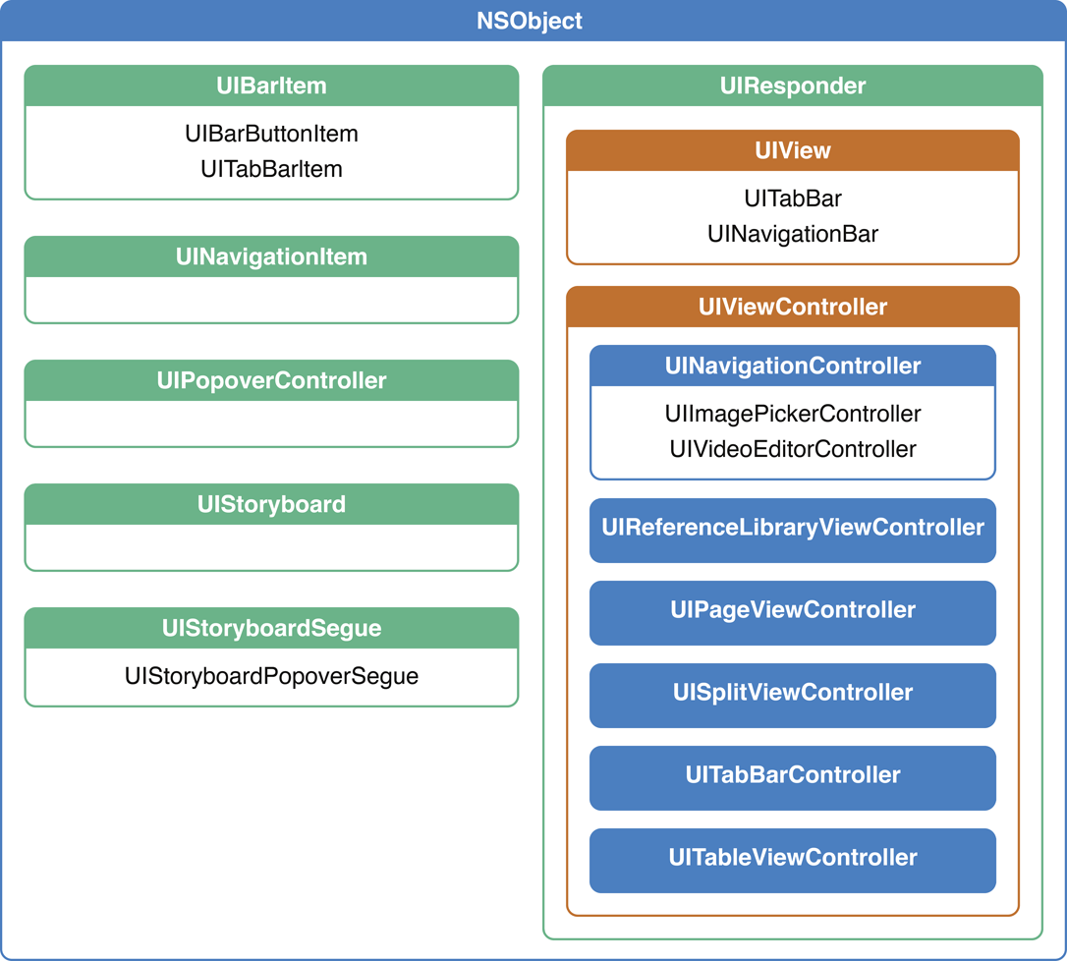
A Taxonomy of View Controllers

Slide 37
For content view controllers, the most common parent classes are as follows:
Use UITableViewController specifically when the view controller’s main view is a table.
Use UICollectionViewController specifically when the view controller’s main view is a collection view.
Use UIViewController for all other view controllers.

Slide 38
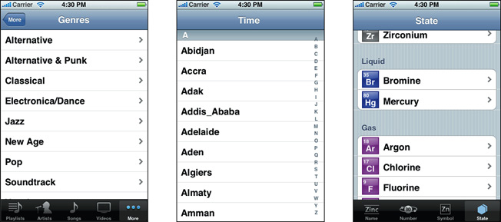
Table Views
plain
grouped
A table view presents a scrollable list of items that may be divided into sections.
Set style at initialization – Cannot be changed later
- init(frame: CGRect, style: UITableViewStyle)

Slide 39
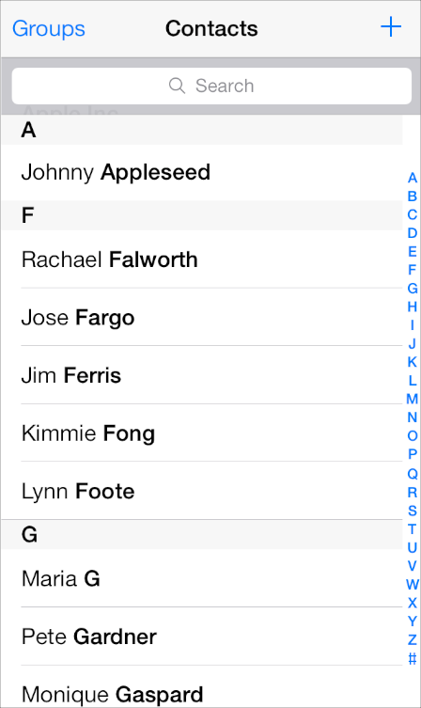
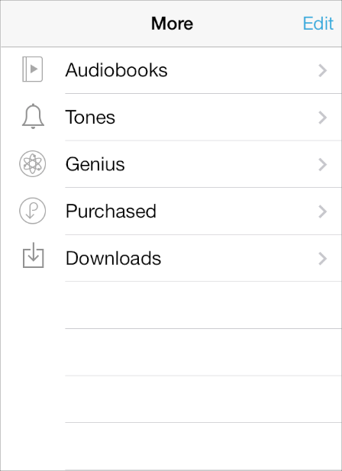
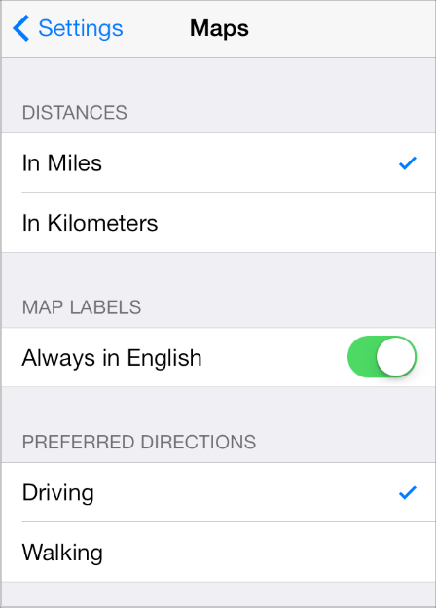




plain style
grouped style
A table view presents data in a scrolling single-column list of multiple rows.
Table view element:

Slide 40
UITableViewController is almost always the dataSource for the UITableView.
weak var dataSource: UITableViewDataSource? { get set }
Asks the datasource for the number of rows up front and then for data as each row comes on screen
var numberOfSections: Int { get }
func numberOfRows(inSection section: Int) -> Int
func cellForRow(at indexPath: IndexPath) -> UITableViewCell?
indexPath.section is the section, indexPath.row is the row.

Slide 41
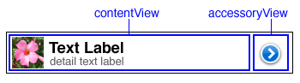
UITableViewCell
A UIView subclass for drawing a row in the table view.
Has the following properties
var textLabel: UILabel? { get }
var detailTextLabel: UILabel? { get }
var imageView: UIImageView? { get }
Has the following initializer ( no Frame):
init(style: UITableViewCellStyle, reuseIdentifier: String?)

Slide 42



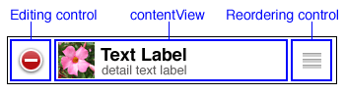
disclosureIndicator
detailDisclosureButton
checkmark
detailButton
none
In editing mode

Slide 43
UITableViewController Implements loadView
Can still have a .xib by creating a .xib file with the same name as your UITableViewController subclass.
Properly selects and deselects rows at right time if pushing in navigation controller.
Reloads the data just before the view appears.
Handles the Edit button (self.editButtonItem) to make rows editable.
Flashes scroll indicators when the view comes on screen.
Makes sure there’s room for a keyboard if there is an editable view inside a cell in the table.

Slide 44
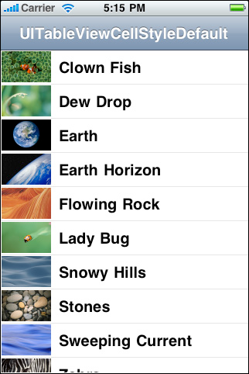
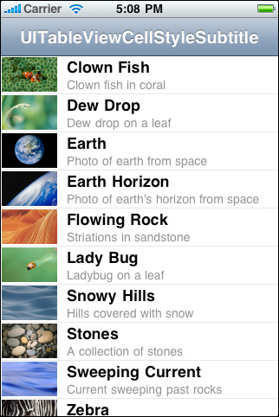
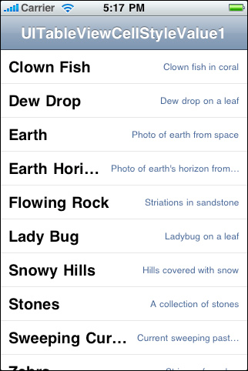
UIViewTableCell Styles

Slide 45
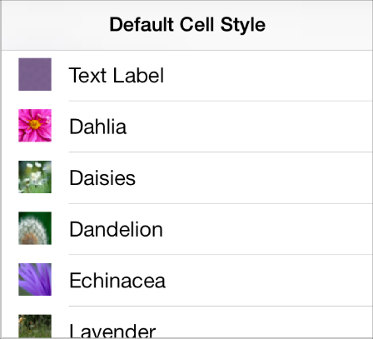
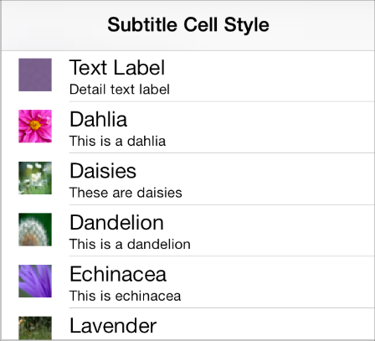
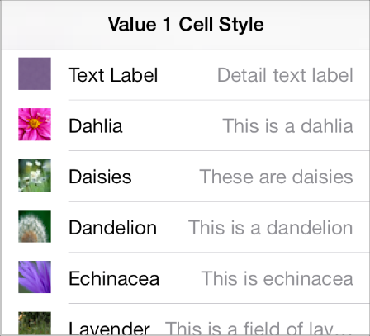
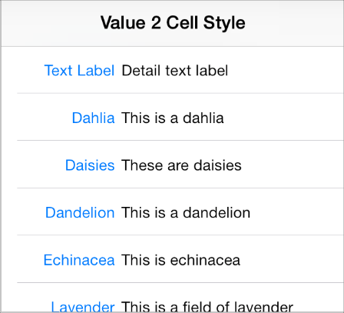
Default (default). The default cell style includes an optional image in the left end of the row, followed by a left-aligned title.
Subtitle (subtitle). The subtitle style includes an optional image in the left end of the row, followed by a left-aligned title on one line and a left-aligned subtitle on the line below.
Value 1 (value1). The value 1 style displays a left-aligned title with, on the same line, a right-aligned subtitle in a lighter font.
Value 2 (value2). The value 2 style displays a right-aligned title in a blue font, followed on the same line by a left-aligned subtitle in a black font. Images don’t fit well in this style.

Slide 47
TableViewCell Configuration
override func tableView(_ tableView: UITableView, cellForRowAt indexPath: IndexPath) -> UITableViewCell
{
let cell = tableView.dequeueReusableCell(withIdentifier: "Cell", for: indexPath)
let object = objects[indexPath.row] as! NSDate
cell.textLabel!.text = object.description
cell.accessoryType = .detailDisclosureButton
return cell
}

Slide 48
Reuse Identifier to Each Cell:
Reuse identifiers facilitate the creation and recycling of your table’s cells.
Reuse identifier is a string that you assign to each prototype cell of your table. ( identifier attribute in storyboard.
Each cell in a table view must have a unique reuse identifier.
- When you need a cell object at runtime, call the table view’s dequeueReusableCell(withIdentifier:for:) method, passing the reuse identifier for the cell you want.
The table view maintains an internal queue of already-created cells.
If the queue contains a cell of the requested type, the table view returns that cell.
If not, it creates a new cell using the prototype cell in your storyboard.
Reusing cells improves performance by minimizing memory allocations during critical times, such as during scrolling.
var cell = tableView.dequeueReusableCell(withIdentifier: “myCellType”, for: indexPath)

Slide 49
More on dataSource functions
The dataSource controls what is displayed
override func tableView(_ tableView: UITableView, commit editingStyle: UITableViewCellEditingStyle, forRowAt indexPath: IndexPath)
UITableViewCellEditingStyle.delete // delete the data at the specified indexPath
UITableViewCellEditingStyle.insert // insert a new row at the specified indexPath
override func tableView(_ tableView: UITableView, canEditRowAt indexPath: IndexPath) -> Bool
Activate the delete action by:
clicking a button which sets the UITableView open var isEditing: Bool.
BarItem button: self.navigationItem.rightBarButtonItem = self.editButtonItem().
To add a custom edit button, call the tableView setEditing(_ editing: Bool, animated animate: Bool) method.
Moving rows : tableView:moveRowAtIndexPath:toIndexPath:

Slide 50
optional public func tableView(_ tableView: UITableView, willSelectRowAt indexPath: IndexPath) -> IndexPath?
optional public func tableView(_ tableView: UITableView, willDeselectRowAt indexPath: IndexPath) -> IndexPath?
// Called after the user changes the selection.
optional public func tableView(_ tableView: UITableView, didSelectRowAt indexPath: IndexPath)
optional public func tableView(_ tableView: UITableView, didDeselectRowAt indexPath: IndexPath)

Slide 51
UITableViewDelegate
The delegate controls how the UITableView is displayed
Notification that a row is about to appear on screen
optional public func tableView(_ tableView: UITableView, willDisplay cell: UITableViewCell, forRowAt indexPath: IndexPath)
Set some cell properties such as backgroud color (cell.backgroundColor = UIColor().green )
Row selection
Where you put your code to handle selection of a row ...
didSelectRowAtIndexPath:(NSIndexPath *)indexPath
Controlling the height of cells
optional public func tableView(_ tableView: UITableView, heightForRowAt indexPath: IndexPath) -> CGFloat;
Controlling the height of headers and footers
tableView(_ tableView: UITableView, heightForHeaderInSection section: Int)
Provide provide custom header/footer views
tableView(_ tableView: UITableView, viewForHeaderInSection section: Int)
Editing style for cells
tableView(_ tableView: UITableView, editingStyleForRowAt indexPath: IndexPath)
Preventing selection of cells
tableView(_ tableView: UITableView, willSelectRowAt indexPath: IndexPath) -→ return nil if selection is disabled
Very common for dataSource and delegate to be the same object
Examples:
http://developer.apple.com/library/ios/#samplecode/TableViewSuite/Listings/ReadMe_txt.html

Slide 52
UITableViewRowAction:
Defines a single action to present when user swipes horizontally in a table row.
By default, it shows a delete button
Use each instance for a single action to perform
It includes the text, formatting info, and behavior of the corresponding button

Slide 53
Container view controller additional role
A content view controller manages all of its views by itself.
A container view controller manages its own views plus the root views from one or more of its child view controllers.
The container does not manage the content of its children.
It manages only the root view, sizing and placing it according to the container’s design.

Slide 54
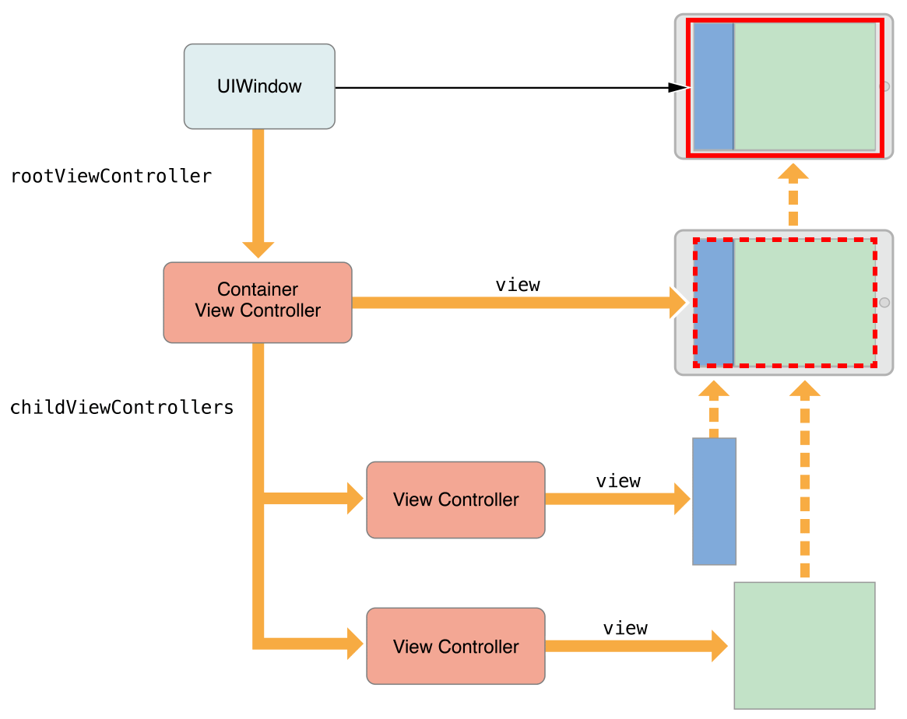
A container acting as the root view controller

Slide 55
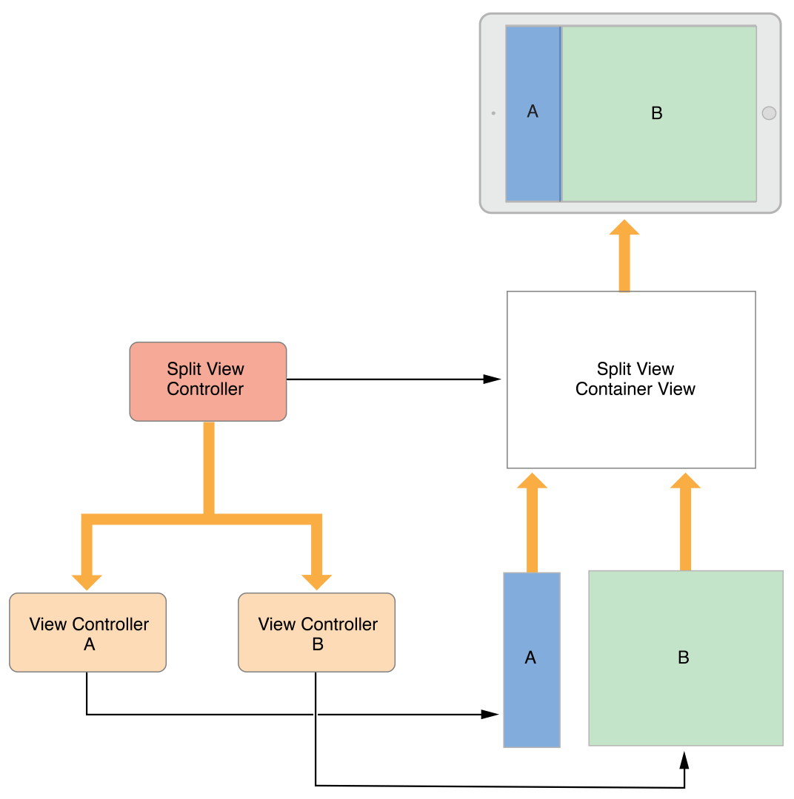
The split view controller manages the overall size and position of its child views –
The child view controllers manage the actual contents of those views

Slide 56
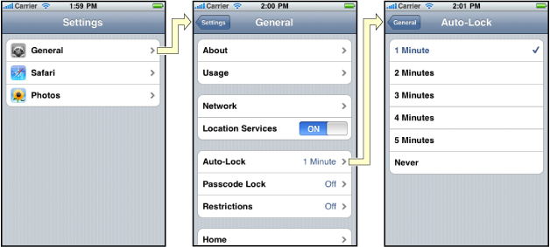
UINavigationController

Slide 57
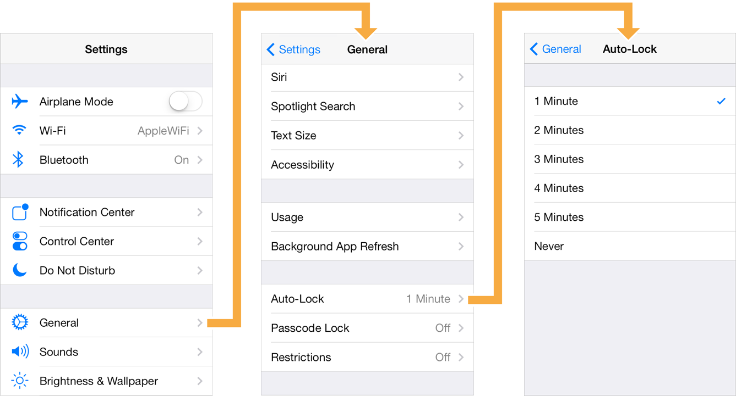
UINavigationController

Slide 58
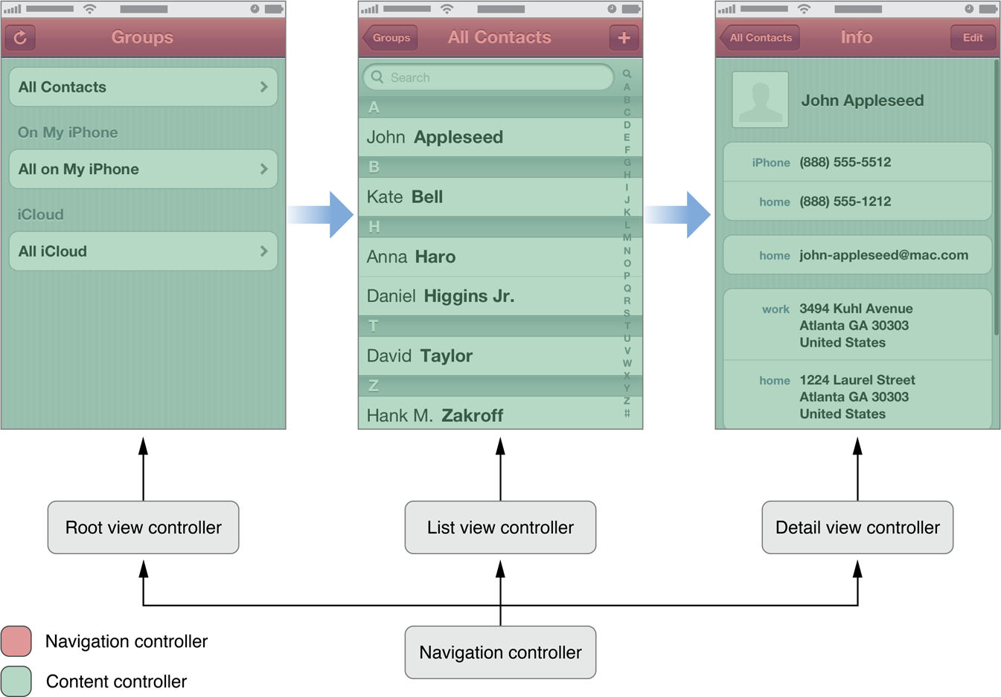

Slide 59
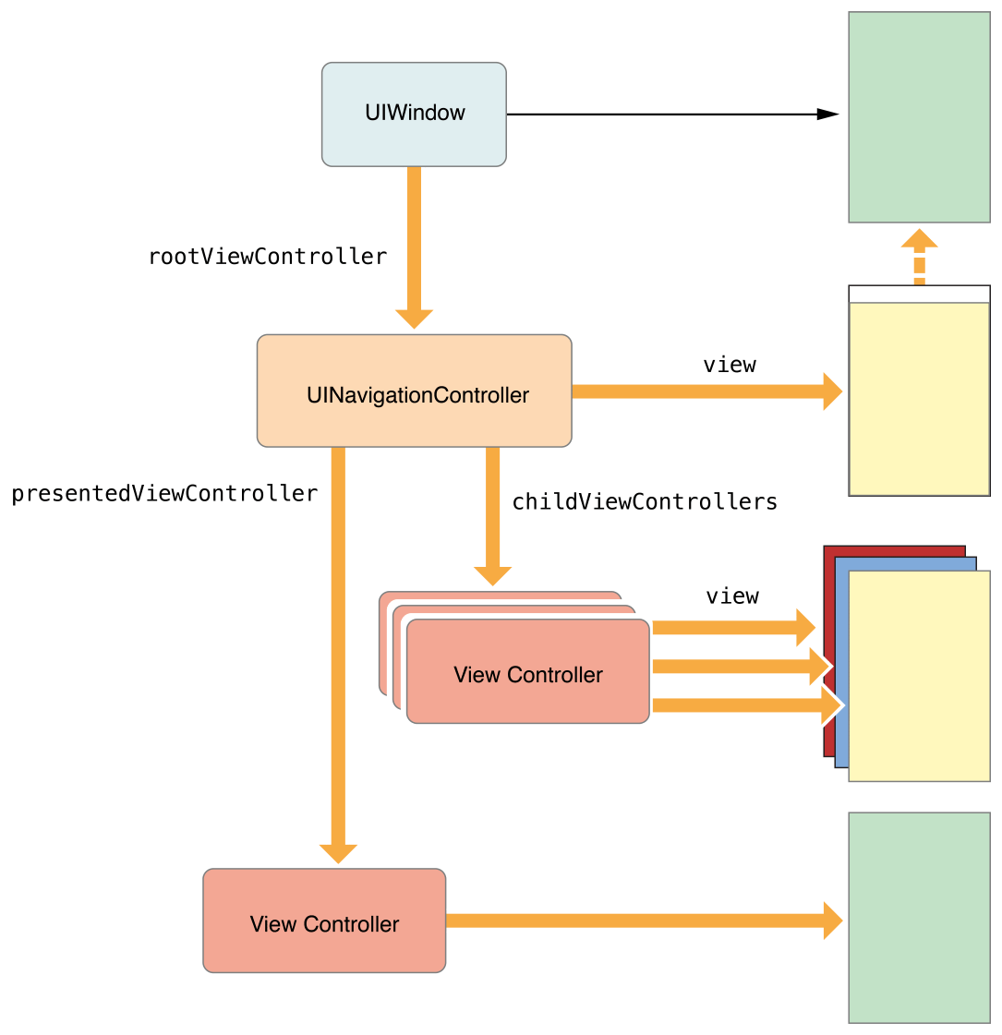
The Navigation controller acts as the presenting view controller and initiates the
presentation

Slide 60
manages the currently displayed screens using the navigation stack.
Push new view controllers onto the stack using the pushViewController(_ viewController: UIViewController, animated: Bool) method
Pop view controllers using the popViewController(animated: Bool) method.
It provides a back button that pops the top view controller in response to user interactions.
It notifies its delegate object in response to changes in the active view controller.
The delegate object is a custom object provided by the application that conforms to the UINavigationControllerDelegate protocol.
Navigation controllers have their own view that is accessible through the view property.

Slide 61
init(rootViewController: UIViewController)
Initializes and returns a newly created navigation controller.
init(rootViewController: UIViewController)
var visibleViewController: UIViewController?
The view controller associated with the currently visible view in the navigation interface. (read-only)
var visibleViewController: UIViewController? { get }
The currently visible view can belong either to the view controller at the top of the navigation stack or to a view controller that was presented modally.
var topViewController: UIViewController?
The view controller at the top of the navigation stack. (read-only)
var topViewController: UIViewController? { get }

Slide 62
var viewControllers: [UIViewController]
The view controllers currently on the navigation stack.
var viewControllers: [UIViewController] { get set }
The root view controller is at index 0 in the array, the back view controller is at index n-2, and the top controller is at index n-1, where n is the number of items in the array.
Assigning a new array of view controllers to this property is equivalent to calling the setViewControllers:animated: method with the animated parameter set to NO.
func setViewControllers([UIViewController], animated: Bool)
Replaces the view controllers currently managed by the navigation controller with the specified items.
func setViewControllers(_ viewControllers: [UIViewController], animated: Bool)
viewControllers The view controllers to place in the stack. The front-to-back order of the controllers in this array represents the new bottom-to-top order of the controllers in the navigation stack. Thus, the last item added to the array becomes the top item of the navigation stack.

Slide 63
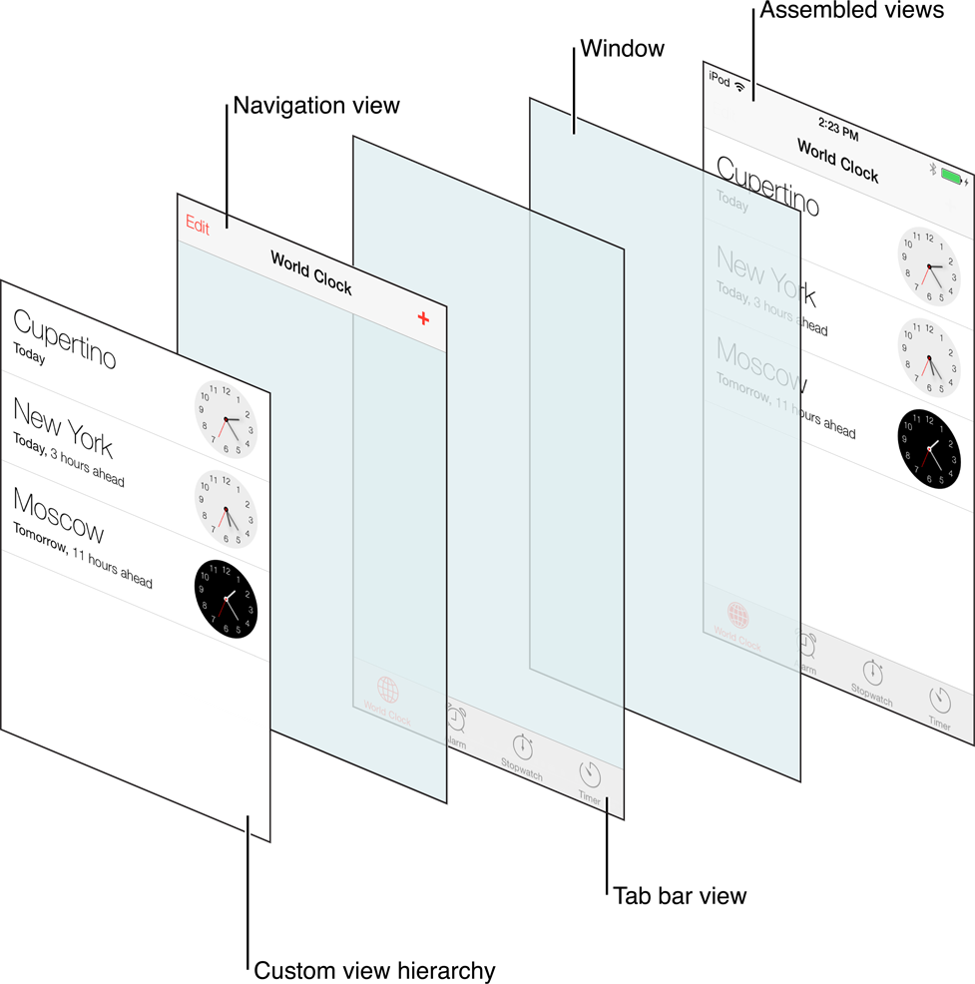
The views of a navigation controller

Slide 64
func pushViewController(_ viewController: UIViewController, animated: Bool)
Pushes a view controller onto the receiver’s stack and updates the display.
The view controller that is pushed onto the stack cannot be an instance of tab bar controller and it must not already be on the navigation stack.
func popToRootViewController(animated: Bool) -> [UIViewController]?
func popToRootViewController(animated: Bool) -> [UIViewController]?
func popViewController(animated: Bool) -> UIViewController?

Slide 65
Can hide and show the navigation bar using the isNavigationBarHidden: Bool { get set } property or setNavigationBarHidden(_ hidden: Bool, animated: Bool) method.
leftBarButtonItem property of the view controller’s navigation item
backBarButtonItem property
titleView property of the view controller’s navigation item.
If no custom right bar button item is specified, the navigation bar displays nothing on the right side of the bar.

Slide 66
Navigation Controller Toolbar
The navigation toolbar is hidden by default
Can show it for your navigation interface by calling the setToolbarHidden(_ hidden: Bool, animated: Bool) method
Toolbar obtains its current set of items from the toolbarItems property of the active view controller.
When the active view controller changes, the navigation controller updates the toolbar items to match the new view controller, animating the new items into position when appropriate.
The delegate object should call setToolbarHidden: to toggle the visibility of the toolbar during push and pop operations in case the toolbar is not applicable to all view controllers.

Slide 67
navigationController is a property in UIViewController that returns the UINavigationController it is in (if any, else nil).
To talk back from the pushed controller, use delegation property:
vcTobePushed.delegate = self;

Slide 68
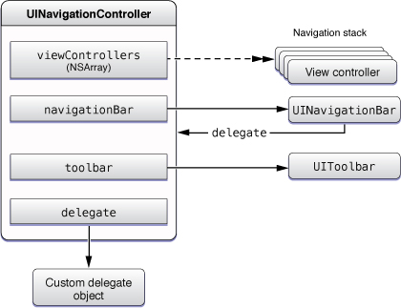
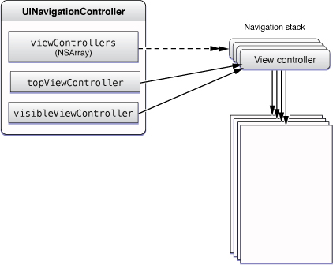
The Objects of a Navigation Interface

Slide 69
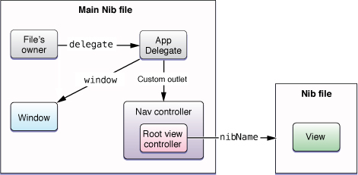
Loading a Navigation Interface from a Nib File

Slide 70
Adopting a Full-Screen Layout for Navigation Views
When determining whether a view should be sized to fill all or most of the screen, a navigation controller considers several factors, including the following:
Is the underlying window (or parent view) sized to fill the entire screen bounds?
Is the navigation bar configured to be translucent?
Is the navigation toolbar (if used) configured to be translucent?
Is the underlying view controller’s wantsFullScreenLayout property set to YES?

Slide 71
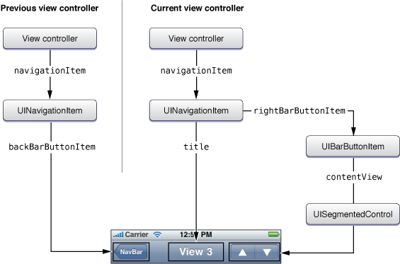
Navigation Bar Appearance

Slide 72
navigationItem :UINavigationItem
leftBarButtonItem/leftBarButtonItems
property, but the navigation controller displays those buttons only when space is available.
backBarButtonItem
property for the Back button you want to display when the current view controller is just below the topmost view controller. Doesn’t appear when the current view controller is topmost
backButtonTitle: String? The custom title of the Back button.
hidesBackButton to hide/show back button
backButtonDisplayMode: The display mode of the Back button. ( default, generic, minimal)
leftItemsSupplementBackButton: Bool
To display the leftBaarButtonItems in addition to, and not instead of, the Back button.
rightBarButtonItem/rightBarButtonItems:
An array of custom bar button items to display on the right (or trailing) side of the navigation bar when the navigation item is the top item

Slide 73
var titleView: UIView?
A custom view that displays in the center of the navigation bar when the receiver is the top item.
var largeTitleDisplayMode:
mode for displaying the title of the navigation bar.( automatic, always, never)
var prompt: String?
A single line of text that displays at the top of the navigation bar.
var searchController: UISearchController?
The search controller to integrate into your navigation interface.
var hidesSearchBarWhenScrolling: Bool
A Boolean value that indicates whether the app hides the integrated search bar when scrolling any underlying content
When specifying buttons for a navigation item, use UIBarButtonItem objects.
To display custom views in the navigation bar, wrap those views inside a UIBarButtonItem object before adding them to the navigation item.

Slide 74
var target: AnyObject?
The object that receives an action when the user selects the item.
var action: Selector?
The selector defining the action message to send to the target object when the user taps this bar button item.

Slide 75
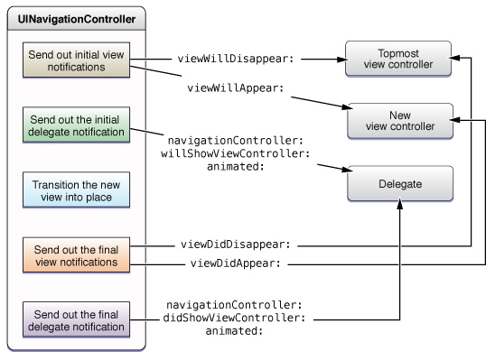
Messages sent during stack changes

Slide 76
Presenting Versus Showing a View Controller
The UIViewController class offers two ways to display a view controller:
func show(_ vc: UIViewController, sender: Any?)
func showDetailViewController(_ vc: UIViewController, sender: Any?):
offer the most adaptive and flexible way to display view controllers.
let the presenting view controller decide how best to handle the presentation
a container view controller might incorporate the view controller as a child instead of presenting it modally. The default behavior presents the view controller modally.
The present(_:animated:completion:)
always displays the view controller modally.

Slide 77
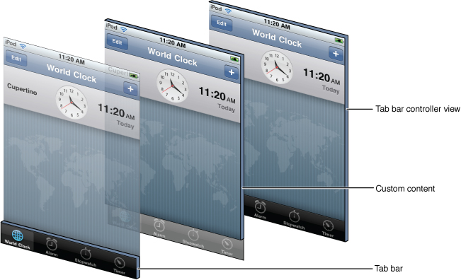
Tab Bar Controllers
Manage Independent Sets of View Controllers

Slide 78
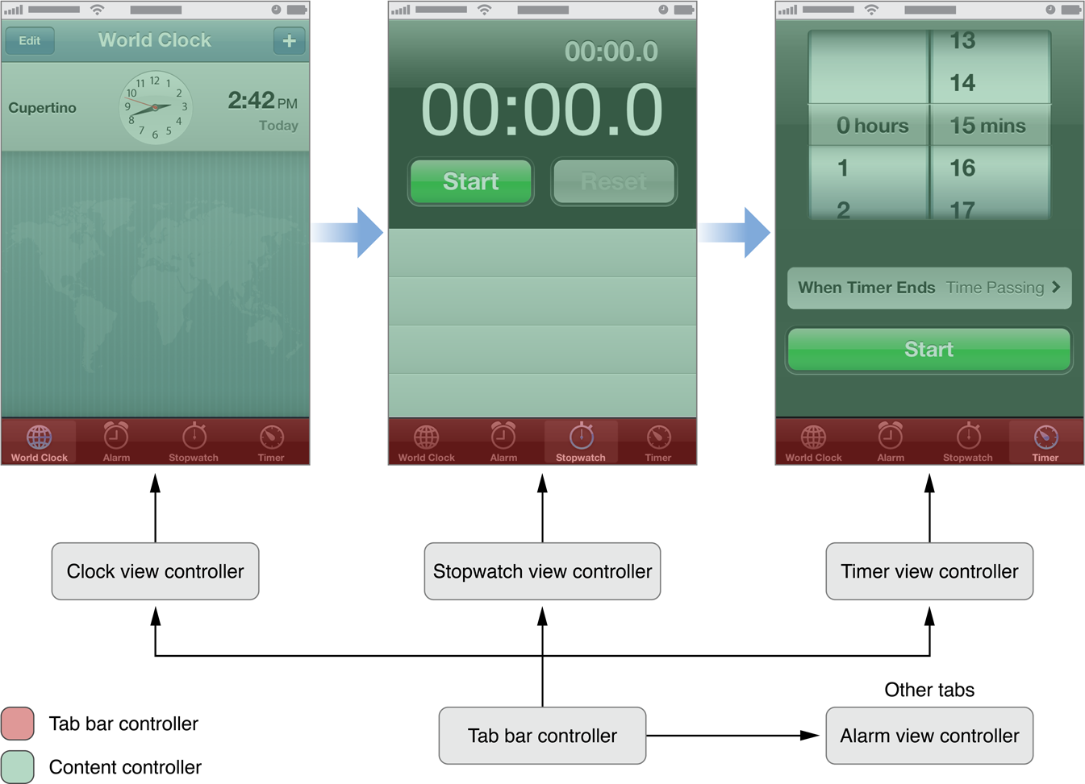
Different modes of the Clock app

Slide 79
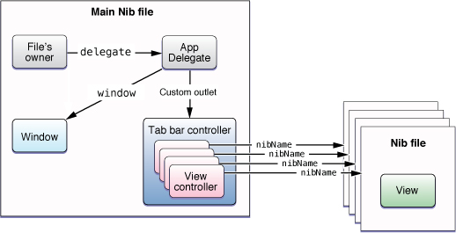
Creating a Tab Bar Interface Using a Nib File

Slide 80
Creating a tab bar controller from scratch
- (void)applicationDidFinishLaunching:(UIApplication *)application {
let tabBarController = UITabBarController()
let vc1 = MyViewController ()
let vc2 = MyOtherViewController()
let icon1 = UITabBarItem(title: "Title", image: UIImage(named: "someImage.png"), selectedImage: UIImage(named: "otherImage.png"))
vc1.tabBarItem = icon1
tabBarController.viewControllers = [vc1,vc2]
window.rootViewController = tabBarController
}
- var selectedViewController: UIViewController?
- var selectedIndex: Int { get set }

Slide 81
Remove a tab
NSMutableArray* newArray = [NSMutableArray arrayWithArray:self.tabBarController.viewControllers];
[newArray removeObject:self];
[self.tabBarController setViewControllers:newArray animated:YES];
Prevent a tab selection
Implement the tabBarController(_:shouldSelect:) method on the object.
tabBarController(_:didSelect:) Tells the delegate that the user selected an item in the tab bar ( both from UITabBarControllerDelegate )
var moreNavigationController: UINavigationController { get }
The view controller that manages the More navigation interface. (read-only)
var customizableViewControllers: [UIViewController]? { get set }
controls which items in the tab bar can be rearranged by the user.
To assign a badge to a tab, assign a non-nil value to the badgeValue property of the corresponding tab bar item.
Tab bar controllers support a portrait orientation by default and do not rotate to a landscape orientation unless all of the root view controllers support such an orientation.
The tab bar controller always resizes the view to prevent it from underlapping the tab bar when the wantsFullScreenLayout property is set.

Slide 82
Other Controllers
UIPopoverController
not actually a view controller itself
Used to present content using a popover, (a visual layer that floats above your application’s window).
UISplitViewController
Manages two panes of information.
The first pane has a fixed width of 320 points and a height that matches the visible window height.
The second pane fills the remaining space.

Slide 83
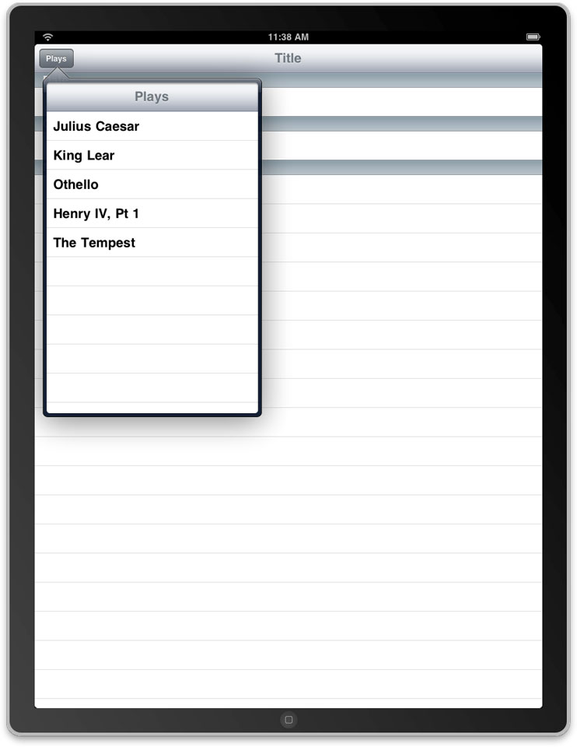
Using a popover to display a master pane

Slide 84
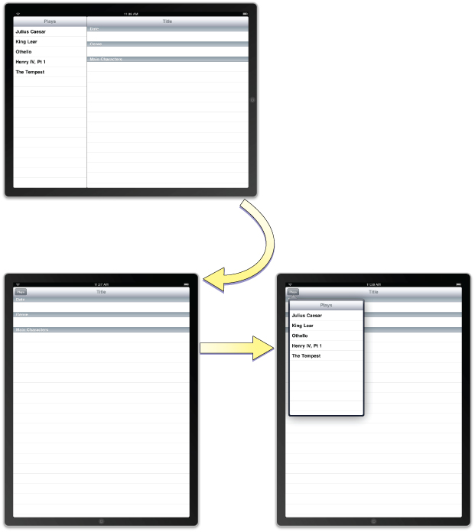
A split view interface

Slide 85
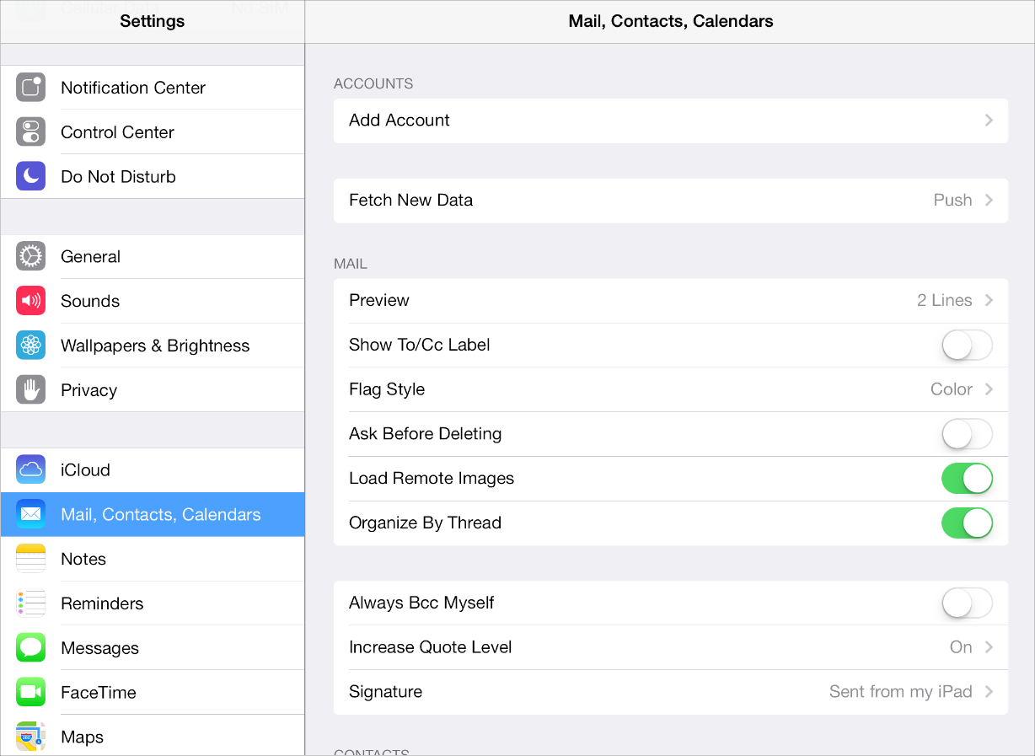
split view controller ( iOS7)

Slide 86
Creating a split view controller programmatically
func application(_ application: UIApplication, didFinishLaunchingWithOptions launchOptions: [UIApplicationLaunchOptionsKey: Any]?) -> Bool {
{
var splitViewController = UISplitViewController()
var rootViewController = RootViewController()
var detailViewController = DetailViewController() splitViewController.viewControllers = [rootViewController,detailViewController]
self.window = UIWindow(frame: UIScreen.mainScreen().bounds) self.window!.backgroundColor = UIColor.whiteColor()
self.window = UIWindow(frame: UIScreen.mainScreen().bounds)
self.window!.rootViewController = splitViewController self.window!.makeKeyAndVisible()
return true
}

Slide 87
UISplitViewControllerDisplayMode:
Automatic, primaryHidden, allVisible, primaryOverlay
Applicable only when in expanded arrangement
var preferredPrimaryColumnWidthFraction: CGFloat (var primaryColumnWidth: CGFloat)
Used to adjust the primary view controller’s width
var isCollapsed: Bool
Indicates whether only one of the child view controllers is displayed.
var displayModeButtonItem: UIBarButtonItem
A preconfigured bar button item that changes the display mode
Tapping this button changes the display mode to the value last returned by the delegate’s targetDisplayModeForAction(in:) method.
var preferredDisplayMode: UISplitViewControllerDisplayMode
property to specify the display mode that you prefer to use ( automatic by default)

Slide 88
Modal View Controllers
Any view controller can be presented modally by an application
To present a view controller modally, do the following:
Create the view controller to present.
Set the modalTransitionStyle property of the view controller to the desired value.
UIModalTransitionStyle.coverVertical , .flipHorizontal, .crossDissolve, .partialCurl
Assign a delegate object where appropriate. (The delegate is used primarily by system view controllers to notify the code when the view controller is ready to be dismissed. )
Call the present(_:animated:completion:) method of the current view controller, passing in the view controller to present modally.
Call dismiss(animated:completion:) Dismisses the modal view controller that was presented by the receiver.

Slide 89
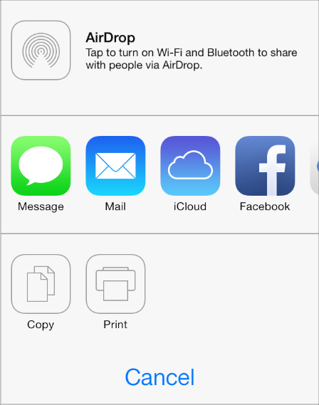
An activity view controller presents a transient view listing system-provided and custom services that can act on some specified content. (UIActivityViewController Class )

Slide 90
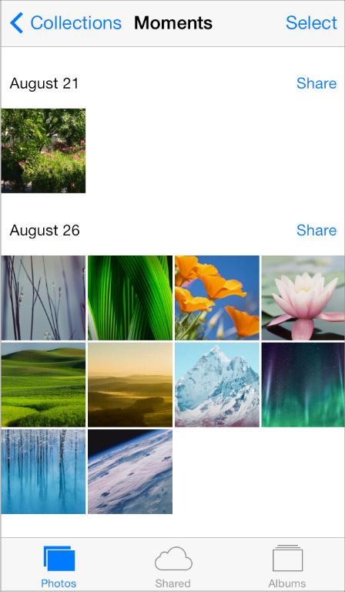
A collection view manages an ordered collection of items and presents them in a customizable layout.

Slide 91
More Controllers
Address Book Controllers
The AddressBookUI framework provides several precooked view controllers that interact with the onboard contacts database.
UIImagePickerController
A utility controller that allows users to select images from onboard albums or to snap a photo or shoot video using the iPhone camera.
MFMailComposeViewController
create mail messages that users can customize
GKPeerPickerController
The GameKit peer picker provides a standard GUI for discovering and connecting to other iPhones. Such as using BlueTooth.
Media Player Controllers
Several controllers that allow you to choose and play music and movies. Such as the MPMediaPickerController

Slide 92
The Address Book UI framework provides:
three view controllers
one navigation controller
for common tasks related to working with the Address Book database and contact information.
ABPeoplePickerNavigationController
prompts the user to select a person record from their address book.
ABPersonViewController
displays a person record to the user and optionally allows editing.
ABNewPersonViewController
prompts the user create a new person record.
ABUnknownPersonViewController
prompts the user to complete a partial person record, optionally allows them to add it to the address book.

Slide 93
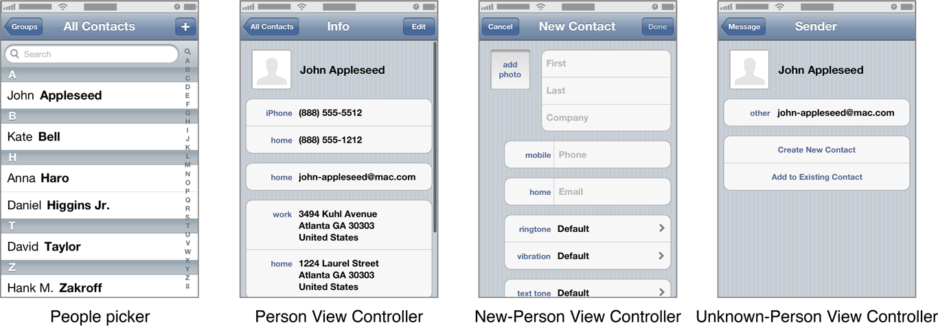
The Address Book UI framework view controllers

Slide 94
Loading a picture using UIImagePickerController
-(IBAction) getPhoto:(id) sender {
// UIImagePickerController is a view controller that lets a user pick media from their photo library.
let picker = UIImagePickerController()
// Only allow photos to be picked, not taken.
picker.sourceType = .photoLibrary
picker.delegate = self;
if((UIButton *) sender == choosePhotoBtn) {
picker.sourceType = .photoLibrary
/*.savedPhotoAlbum*/
} else {
picker.sourceType = .camera;
}
present(picker, animated: true, completion: nil)
}

Slide 95
Recording and Editing Video
Use a UIImagePickerController object with a source type of .camera and a media type of kUTTypeMovie
Using the UIImagePickerControllerDelegate protocol, register as a delegate of the image picker.
Delegate object receives a completed video recording by way of the method:
func imagePickerController(_ picker: UIImagePickerController, didFinishPickingMediaWithInfo info: [String : Any])
func imagePickerControllerDidCancel(_ picker: UIImagePickerController
Need to dismiss the picker
dismiss(animated: true, completion: nil)
Need to add a photo library usage description in info.plist
Privacy – Photo Library Usage ……

Slide 96
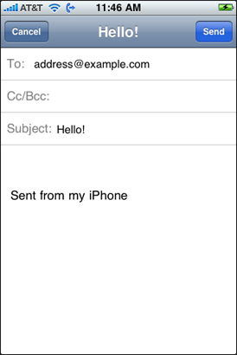
MFMailComposeViewController
Before using this class, you must always check to see if the current device is configured to send email at all using the canSendMail method.
To display the view managed by this view controller, you can use any of the standard techniques for displaying view controllers
The most common way to present this interface is do so modally using the present(:animated: ) method.
let composeVC = MFMessageComposeViewController() composeVC.messageComposeDelegate = self
// Configure the fields of the interface.
composeVC.recipients = ["13142026521"] composeVC.body = ”Hello World!"
// Present the view controller modally.
if MFMessageComposeViewController.canSendText() { self.present(composeVC, animated: true, completion: nil) }

Slide 97
MFMessageComposeViewController
The class provides a standard system user interface for composing SMS (Short Message Service) text messages.
Use this class to configure the initial recipients and body of the message, if desired, and to configure a delegate object to respond to the final result of the user’s action—whether they chose to cancel or send the message.
After configuring initial values, present the view controller modally using the presentModalViewController:animated: method. When done, dismiss it using the dismissModalViewControllerAnimated: method.

Slide 98
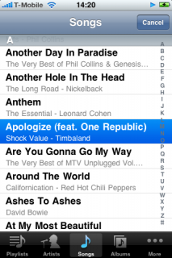
MPMediaPickerController
MPMediaPickerController *mediaPicker = [[MPMediaPickerController alloc] initWithMediaTypes: MPMediaTypeAny]; mediaPicker.delegate = self; mediaPicker.allowsPickingMultipleItems = YES; mediaPicker.prompt = @\"Select musics...\";
To respond to user selections and to dismiss a media item picker, use the MPMediaPickerControllerDelegate protocol

Slide 99
The MPMoviePlayerViewController class (deprecated as of iOS 9.0)
Replaced by: AVPlayerViewController
displays the video content of an AVPlayer object along with system-supplied playback controls.
provide Picture in Picture (PiP) playback on supported iPad models
var player: AVPlayer?
The player that provides the media content for the player view controller.
weak var delegate: AVPlayerViewControllerDelegate?
The delegate object for the player view controller.
you can implement to respond to media playback events associated with an AVPlayerViewController object

Slide 100
import AVFoundation
var playerItem: AVPlayerItem?
var player: AVPlayer?
……
let url = NSURL(string: "url of the audio or video")
playerItem = AVPlayerItem(URL: url!)
player = AVPlayer(playerItem: playerItem!)
let playerLayer = AVPlayerLayer(player: player!)
playerLayer.frame = CGRectMake(0, 0, 300, 50)
self.view.layer.addSublayer(playerLayer)
let videoURL = URL(string: "url of the audio or video”)
let player = AVPlayer(url: videoURL!)
let playerViewController = AVPlayerViewController()
playerViewController.player = player
self.present(playerViewController, animated: true) {
playerViewController.player!.play()
}

Slide 101
UISearchController
An object that manages the display of search results based on interactions with a search bar.
Initialized with:
a search bar
and a view controller responsible for managing the original content to be searched.
When the user interacts with that search bar, the search controller automatically displays a new view controller with the search results that you specify.

Slide 102
EKEventViewController
An object to display the details of a calendar event.
Can set whether users are allowed to edit the event.
If the event is an invitation, where the organizer is not the user, you can set whether a calendar preview is shown.
You need to assign a delegate to an EKEventViewController object to receive a notification when the view controller should be closed.
The delegate must conform to theEKEventViewDelegate protocol.
In the EventKitUI framework

Slide 103
EKEvent
An object that represents an event added to a calendar in Event Kit.
Use the eventWithEventStore: method to create a new event.
Use the properties in the class to get and modify certain information about an event.
Alarms, allDay, attendees ,availability … (16)
You can add and remove alarms from an event with the addAlarm: and removeAlarm: methods.

Slide 104
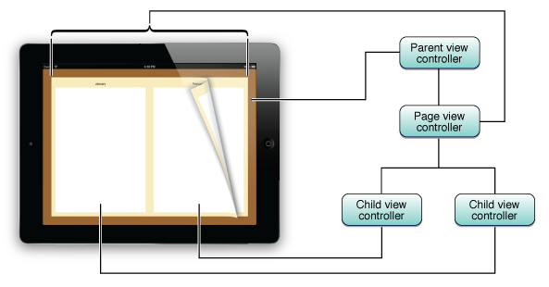
Page View Controllers
It is well suited for presenting content that is accessed in a linear fashion, such as the text of a novel, and for presenting content that has natural page breaks, such as a calendar.

Slide 105
Combined View Controller Interfaces
Custom view controller (or table view controller)
provides a self-contained set of views to present.
Navigation controller
presents multiple view controllers hierarchically.
- Tab bar controller
presents multiple view controllers as different operational modes of the application.
- Split view controller
presents two view controllers side-by-side in landscape orientations. (In portrait orientations, one view controller is displayed in a popover.)
Modal View Controllers
The general rule is that each view controller can incorporate the view controllers preceding it in the list.
You can present almost any view controller modally at any time.
( Using present(_:animated:completion:) )

Slide 106

View Controllers Work Together to Create an App’s Interface

